Slide 1
Cross-Domain Label-Adaptive Stance Detection
Momchil Hardalov,^{1,2} Arnav Arora,^{1,3} Preslav Nakov,^{1,4} Isabelle Augenstein^{1,3}
¹Checkstep Research ²Sofia University ³University of Copenhagen ⁴Qatar Computing Research Institute, HBKU
The 2021 Conference on Empirical Methods in Natural Language Processing (EMNLP 2021)

Slide 2
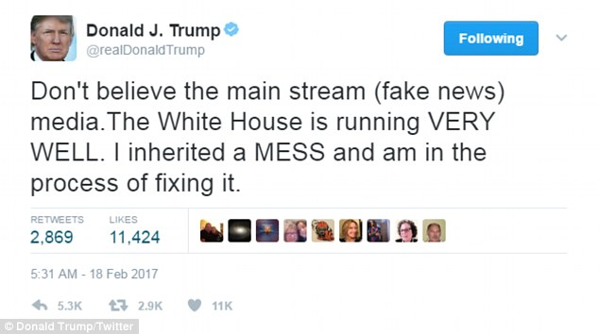
Stance Detection
“Classification of a writer’s viewpoint towards a target”
Notes:
Can be expressed by a person, an organization (UCB), a country (Turkey) etc

Slide 3
Stance Detection: Definitions
(Stance Detection) For an input in the form of a piece of text and a target pair, stance detection is a classification problem where the stance of the author of the text is sought in the form of a category label from this set: {Favor,Against,Neither}... ^{[1]}
(Stance Detection in Social Media) Stance Detection is concerned with individuals’ views toward objects of evaluation through various aspects related to the users’ post and personality traits.^{[2]} The category label is chosen from the set: {Support, Deny, Query, Comment}...^{[3]}
[1] Dilek Küçük and Fazli Can. 2020. Stance Detection: A Survey. ACM Comput. Surv. 53, 1, 12
[2] AlDayel, Abeer, and Walid Magdy. "Stance detection on social media: State of the art and trends." Information Processing & Management 58.4 (2021): 102597.
[3] Mohammad, Saif, et al. "Semeval-2016 task 6: Detecting stance in tweets." Proceedings of the 10th international workshop on semantic evaluation (SemEval-2016). 2016.

Slide 4
Stance Detection: Task Formulations We Cover
Target
Claim
Headline
Person
(Implicit) Topic
Context (Text Piece)
Article
Claim
Post
Sentence
Thread
Tweet
Notes:
Target
Claim
“
Headline
“A meteorite landed in Nicaragua”
Person
Elon Musk, Donald Trump, Billie Eilish[1]
(Implicit) Topic
cloning, abortion, healthcare

Slide 5
Motivation
Consolidation of Stance Detection Data
Combine different task variants/formulations with (some) semantic relation
Mitigate mismatch in label inventories and annotation protocols

Slide 6
Motivation
Consolidation of Stance Detection Data
Combine different task variants/formulations with (some) semantic relation
Mitigate mismatch in label inventories and annotation protocols
Improve In-Domain Learning
Model domain information w/ Mixture-of-Experts
Leverage label connection w/ Label Embeddings

Slide 7
Motivation
Consolidation of Stance Detection Data
Combine different task variants/formulations with (some) semantic relation
Mitigate mismatch in label inventories and annotation protocols
Improve In-Domain Learning
Model domain information w/ Mixture-of-Experts
Leverage label connection w/ Label Embeddings
Obtain Predictions for Out-of-Domain Data
Predict from a set of unseen labels (hard and weak mappings)
Alternative: entirely unsupervised (soft mappings)

Slide 8
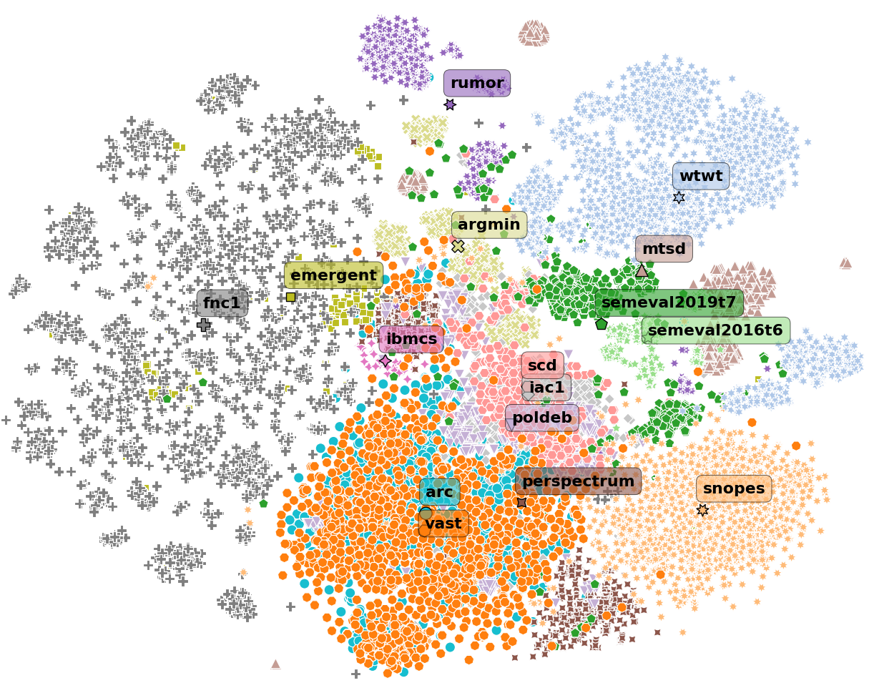
Datasets
Sixteen Diverse Datasets*
Fake news
Rumors
Politics
Company acquisitions
Over Fifty Different Labels
(Well-known) Favor, Against, etc.
(Additional) Neutral, etc.
(Unusual) Other, Question, etc.
Grouped by Source
Debates
News
Social media
Various (mixed sources)
*Largest evaluation collection for stance detection, so far

Slide 9
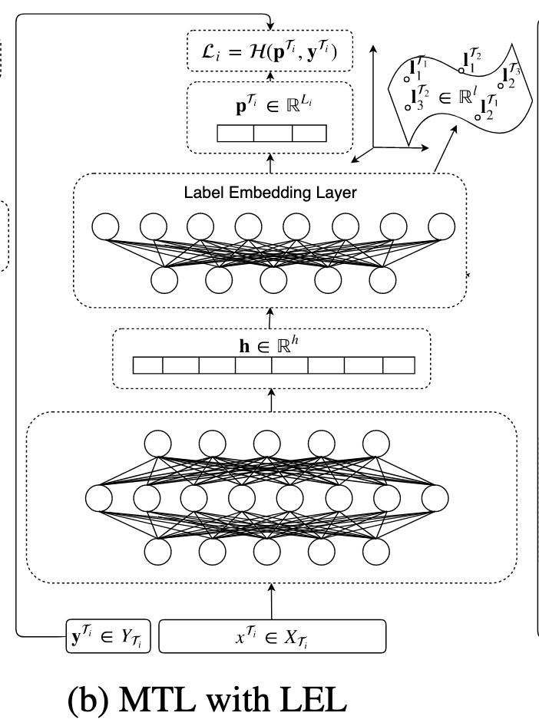
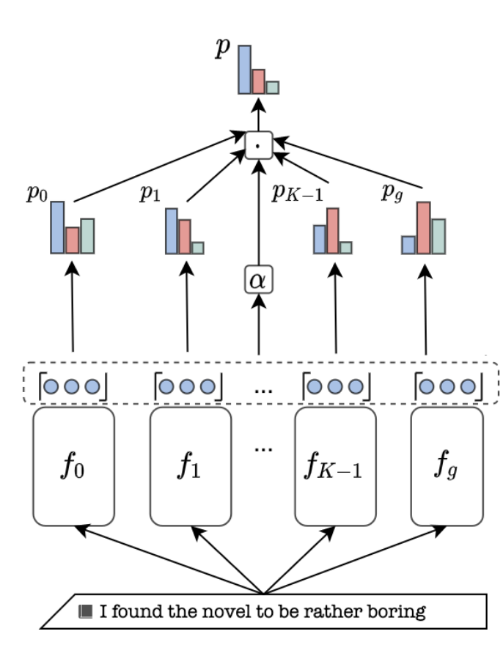
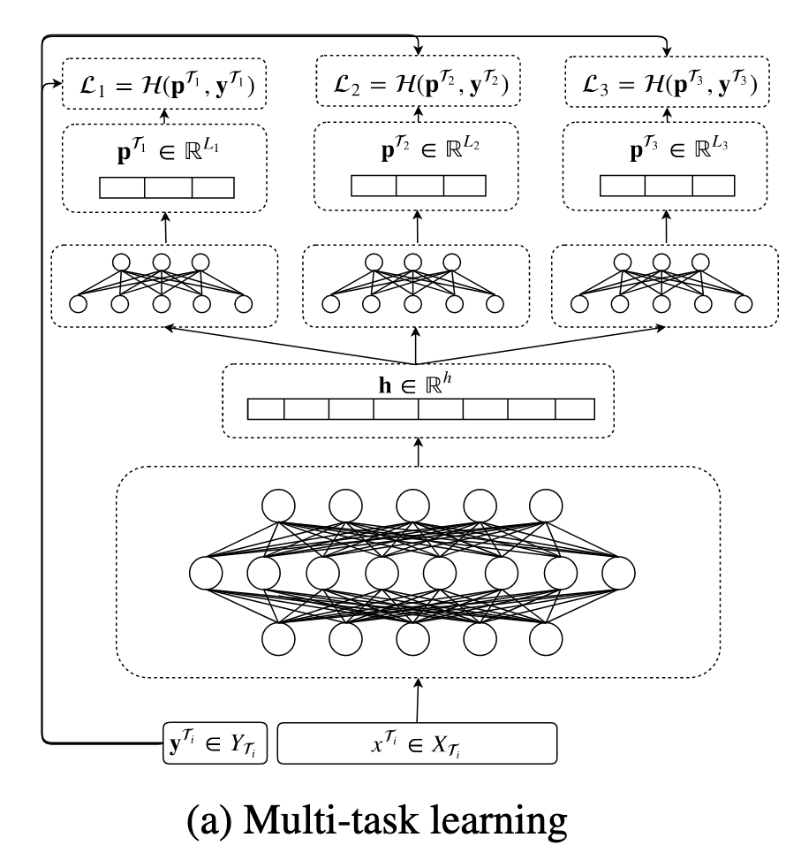
Existing Approaches and Their Limitations
Requires Shared Label Inventory Parameter- Inefficient
Disjoint Label Spaces No Domain Information
No Source Domain Information
(c) Mixture-of-Experts
[a,b] Augenstein, I., Ruder, S. and Søgaard, A., 2018, January. Multi-Task Learning of Pairwise Sequence Classification Tasks over Disparate Label Spaces. In NAACL-HLT. [c] Wright, D. and Augenstein, I., 2020, November. Transformer Based Multi-Source Domain Adaptation. In Proceedings of the 2020 Conference on Empirical Methods in Natural Language Processing (EMNLP) (pp. 7963-7974).
Notes:
MTL does not learn how the tasks interact (except through the shared encoder, if any)
LEL depends on the label embeddings space, but does not have any guidance from the domains
MoE needs the same label inventory for all tasks, that’s why it does not work with many

Slide 10
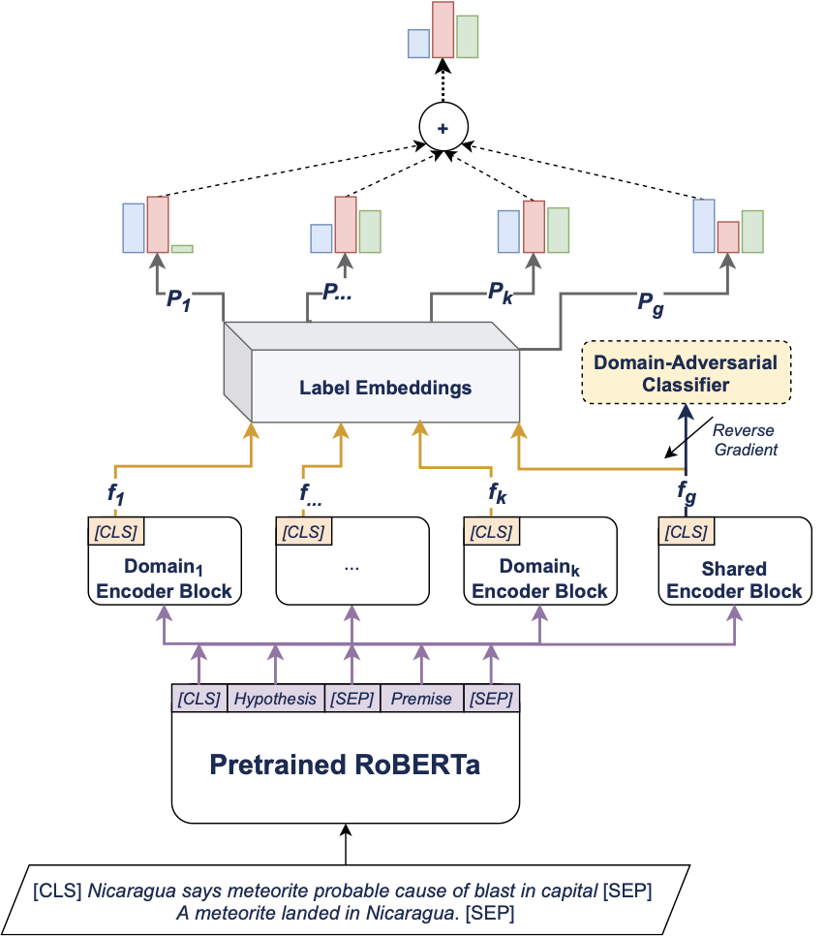
(MoLE) Mixture of Experts with Label Embeddings
Key Characteristics (Our Model)
Mixture of Experts (MoE) w/ a Label Embedding Layer (LEL)
Domain-Adversarial Neural Network (DANN)
Joint Label Space Voting
Parameter-Efficient Model
Notes:
Stable input representations (MoE + DANN)
Stable output representations (LEL)
Parameter-efficiency (Joint model)

Slide 11
(MoLE) Mixture of Experts with Label Embeddings
Key Characteristics (Our Model)
Mixture of Experts (MoE) w/ Label Embeddings Layer (LEL)
Domain-Adversarial Neural Network (DANN)
Joint Label Space Voting
Parameter-Efficient Model
Notes:
Stable input representations (MoE + DANN)
Stable output representations (LEL)
Parameter-efficiency (Joint model)

Slide 12
(MoLE) Mixture of Experts with Label Embeddings
Key Characteristics (Our Model)
Mixture of Experts (MoE) w/ Label Embeddings Layer (LEL)
Domain-Adversarial Neural Network (DANN)
Joint Label Space Voting
Parameter-Efficient Model
Notes:
Stable input representations (MoE + DANN)
Stable output representations (LEL)
Parameter-efficiency (Joint model)

Slide 13
(MoLE) Mixture of Experts with Label Embeddings
Key Characteristics (Our Model)
Mixture of Experts (MoE) w/ Label Embeddings Layer (LEL)
Domain-Adversarial Neural Network (DANN)
Joint Label Space Voting
Parameter-Efficient Model
Notes:
Stable input representations (MoE + DANN)
Stable output representations (LEL)
Parameter-efficiency (Joint model)

Slide 14
(MoLE) Mixture of Experts with Label Embeddings
Key Characteristics (Our Model)
Mixture of Experts (MoE) w/ Label Embeddings Layer (LEL)
Domain-Adversarial Neural Network (DANN)
Joint Label Space Voting
Parameter-Efficient Model
Shared
Notes:
Stable input representations (MoE + DANN)
Stable output representations (LEL)
Parameter-efficiency (Joint model)

Slide 15
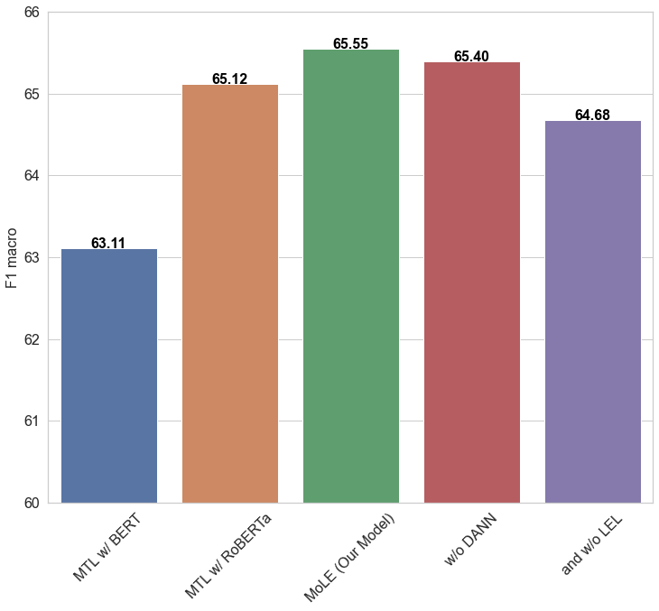
Results: In-Domain
Train/Test on all datasets
MoLE (Our Model) is the best
The highest improvements are in Various
Not so large impact on News
Social Media datasets are very diverse
*Baselines: Random (35.2), Majority class (27.6)
Notes:
RoBERTa outperforms BERT

Slide 16
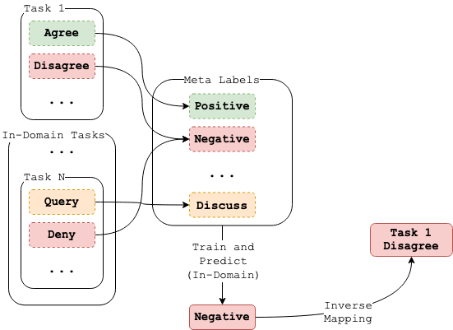
Out-of-Domain Predictions
Predicting Unseen Labels:
Hard Mappings
Weak Mappings
Soft Mappings

Slide 17
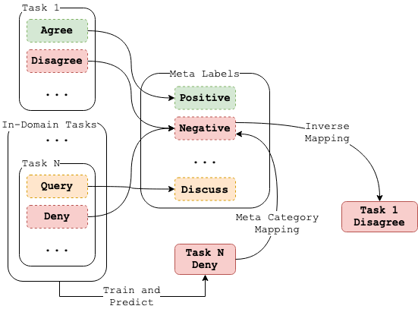
Out-of-Domain Predictions
Predicting Unseen Labels:
Hard Mappings
Weak Mappings
Soft Mappings

Slide 18
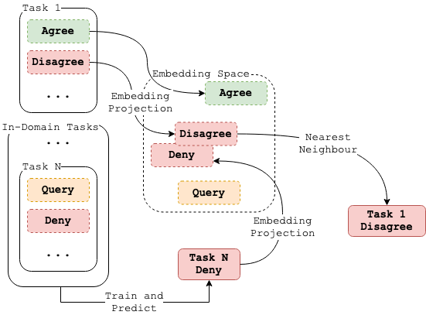
Out-of-Domain Predictions
Predicting Unseen Labels:
Hard Mappings
Weak Mappings
Soft Mappings

Slide 19
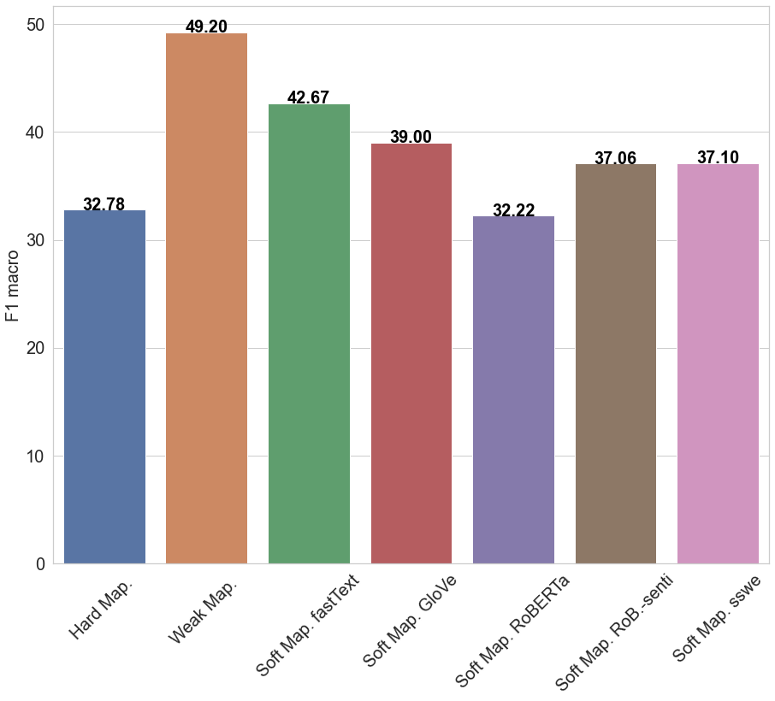
Results: Out-of-Domain
Leave one out for testing, train on others
Hard mappings are worse than random (Worst F1)
*Baselines: Random (35.2), Majority class (27.6)
Notes:
RoBERTa outperforms BERT

Slide 20
Results: Out-of-Domain
Leave one out for testing, train on others
Hard mappings are worse than random (Worst F1)
Weak mappings need hand-crafted embeddings for each label (Best F1)
*Baselines: Random (35.2), Majority class (27.6)
Notes:
RoBERTa outperforms BERT

Slide 21
Results: Out-of-Domain
Leave one out for testing, train on others
Hard mappings are worse than random (Worst F1)
Weak mappings need hand-crafted embeddings for each label (Best F1)
Soft mappings are not always well aligned (but are entirely unsupervised)
*Baselines: Random (35.2), Majority class (27.6)
Notes:
RoBERTa outperforms BERT

Slide 22
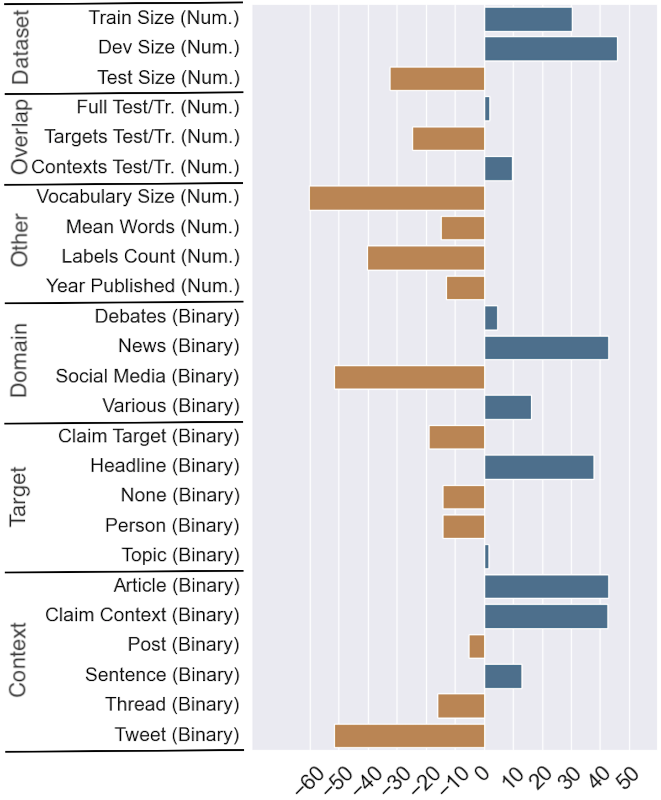
What Features Foretell Success and Failure
(Pearson) Correlation Analysis
* Some of the factors in the analysis are not independent, e.g., Social Media as a domain, and Tweet as a context.

Slide 23
What Features Foretell Success and Failure
(Pearson) Correlation Analysis
Dataset size (more training data -- better)
* Some of the factors in the analysis are not independent, e.g., Social Media as a domain, and Tweet as a context.

Slide 24
What Features Foretell Success and Failure
(Pearson) Correlation Analysis
Dataset size (more training data -- better)
Vocabulary size (richer vocabulary -- harder task)
* Some of the factors in the analysis are not independent, e.g., Social Media as a domain, and Tweet as a context.

Slide 25
What Features Foretell Success and Failure
(Pearson) Correlation Analysis
Dataset size (more training data -- better)
Vocabulary size (richer vocabulary -- harder task)
Social Media (Domain), Tweets (Context) are the hardest
* Some of the factors in the analysis are not independent, e.g., Social Media as a domain, and Tweet as a context.

Slide 26
What Features Foretell Success and Failure
(Pearson) Correlation Analysis
Dataset size (more training data -- better)
Vocabulary size (richer vocabulary -- harder task)
Social Media (Domain), Tweets (Context) are the hardest
News (Domain), Article, Claim (Context) are the easiest
* Some of the factors in the analysis are not independent, e.g., Social Media as a domain, and Tweet as a context.

Slide 27
Summary and Future Work
Summary
We presented the largest study on stance detection to date, covering 16 datasets
We proposed an end-to-end framework (MoLE) for learning from heterogeneous labels
We beat strong SOTA models in-domain
We proposed similarity-based out-of-domain prediction procedure
We offered an interesting testbed for out-of-domain evaluation

Slide 28
Summary and Future Work
Summary
We presented the largest study on stance detection to date, covering 16 datasets
We proposed an end-to-end framework (MoLE) for learning from heterogeneous labels
We beat strong SOTA models in-domain
We proposed similarity-based out-of-domain prediction procedure
We offered an interesting testbed for out-of-domain evaluation
Future Work
Extend to more datasets and languages
Include other stance detection tasks, e.g., stance of a person/medium towards claim/topic

Slide 29
Download the Data, Run New Models!
https://github.com/checkstep/mole-stance
If you have more questions, please contact momchil@checkstep.com

Slide 30
Thank You for Listening!
Please check out our paper for more insights: “Cross-Domain Label-Adaptive Stance Detection”

Slide 31
Old slides afterwards

Slide 32
Research Topics
Consolidation of Stance Detection Data
Different task variants with (some) semantic relation
In-domain Learning
Source information
Label connection
Out-of-Domain Inference
Predict from a set of unseen labels
Can it be entirely unsupervised?

Slide 33
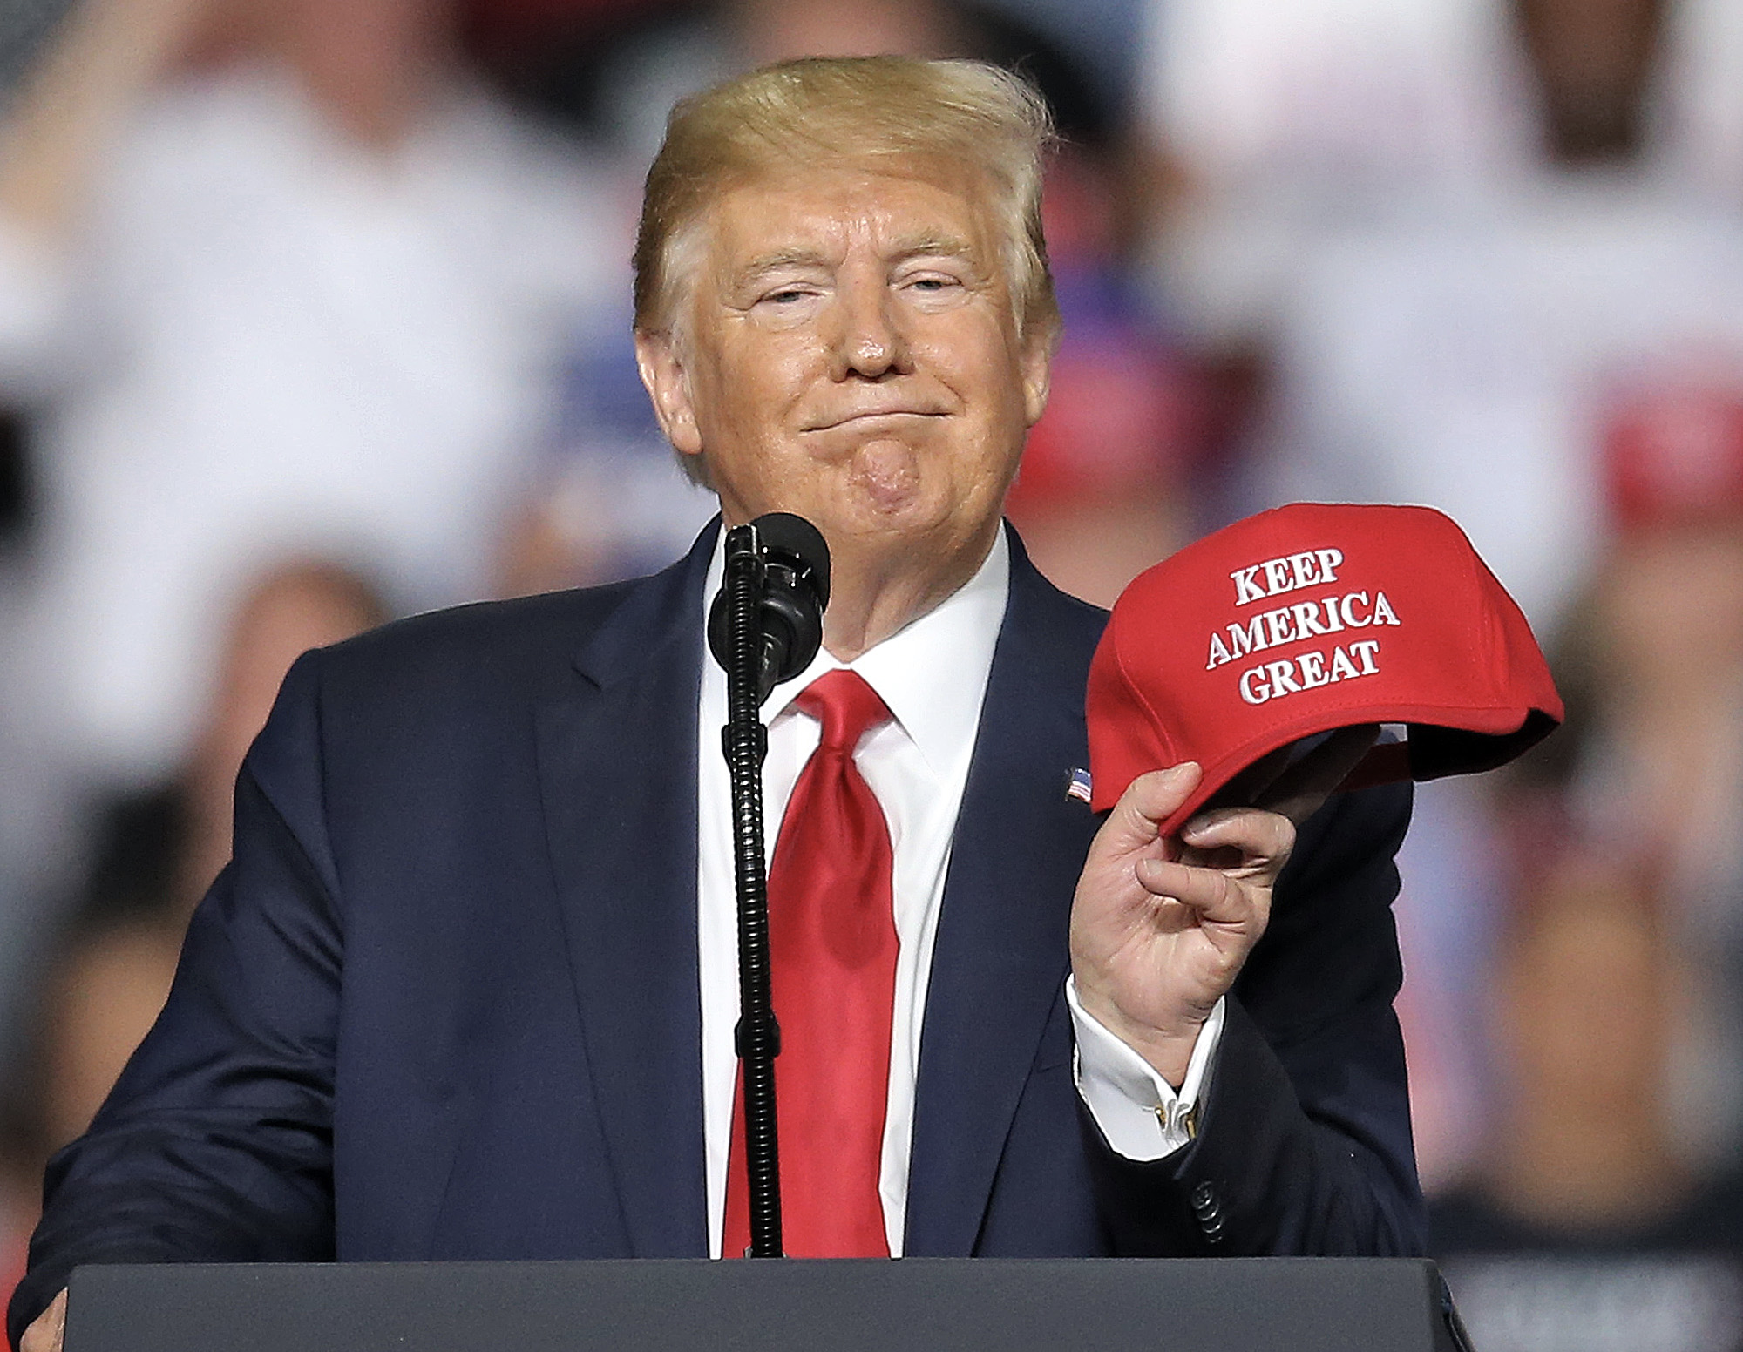
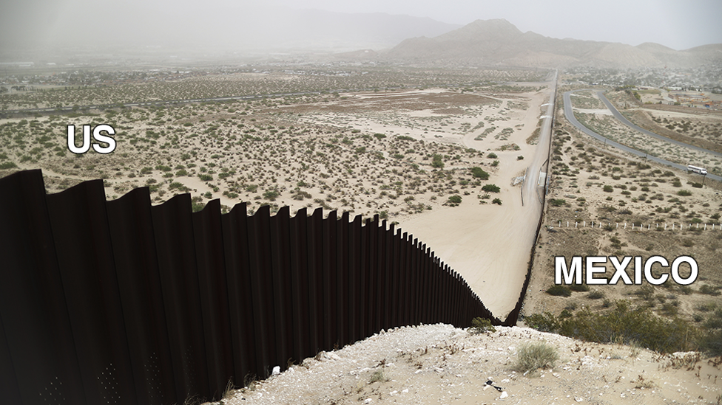
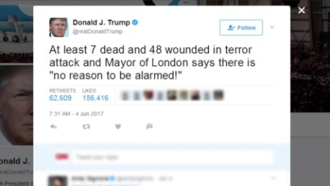
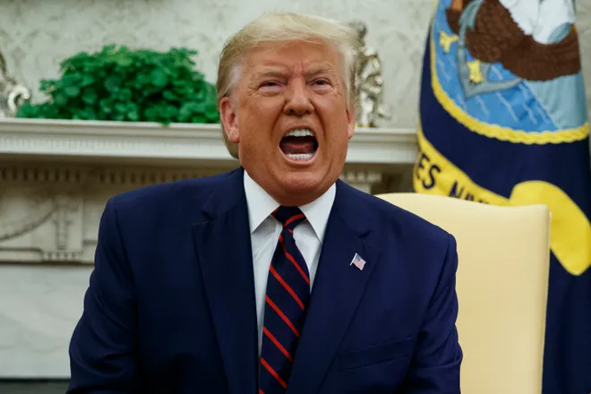
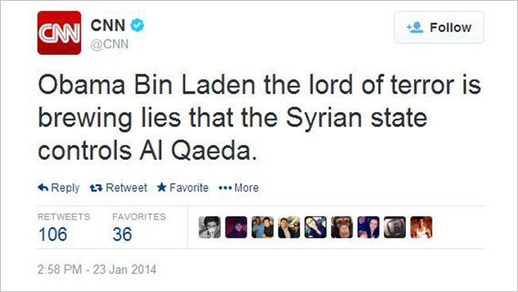
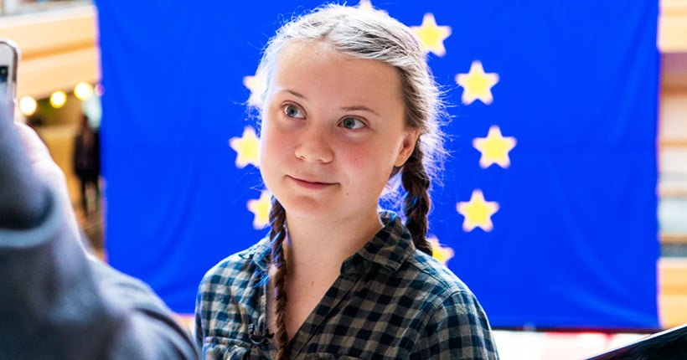
What This Work is NOT About
Person’s general stance towards topic
Claim vs. Claim
Notes:
[1] https://www.bostonherald.com/wp-content/uploads/2019/ 08/trumpms015.jpg
[2] https://www.aruma.com.au/wp-content/uploads/2019/09/ Greta_Thunberg_at_the_Parliament_33744056508.jpg
[3] https://ichef.bbci.co.uk/news/1024/cpsprodpb/98CB/ production/_115051193_trump_wall_1_976_promo-nc.png
[4] https://www.gannett-cdn.com/presto/2019/10/02/USAT/ b5931760-f324-4d58-b9ff-41c3dba83216-AP_Trump.JPG

Slide 34
Stance Detection: Definitions
(Stance Detection Definition 1.1) For an input in the form of a piece of text and a target pair, stance detection is a classification problem where the stance of the author of the text is sought in the form of a category label from this set: {Favor,Against,Neither}. Occasionally, the category label of Neutral is also added to the set of stance categories ... and the target may or may not be explicitly mentioned in the text ... [1]
(Stance Detection Definition 1.2) (Sociolinguistics) Stance detection aims to infer the embedded viewpoint from the writer’s text by linking the stance to three factors, namely, linguistic acts, social interactions, and individual identity. [2]
(Stance Detection Definition 1.3) (Social Media) Stance Detection is concerned with individuals’ views toward objects of evaluation through various aspects related to the users’ post and personality traits. [2]
[1] Dilek Küçük and Fazli Can. 2020. Stance Detection: A Survey. ACM Comput. Surv. 53, 1, Article 12 (May 2020), 37 pages. DOI:https://doi.org/10.1145/3369026
[2, 3] AlDayel, A. and Magdy, W., 2020. Stance Detection on Social Media: State of the Art and Trends. arXiv preprint arXiv:2006.03644.

Slide 35
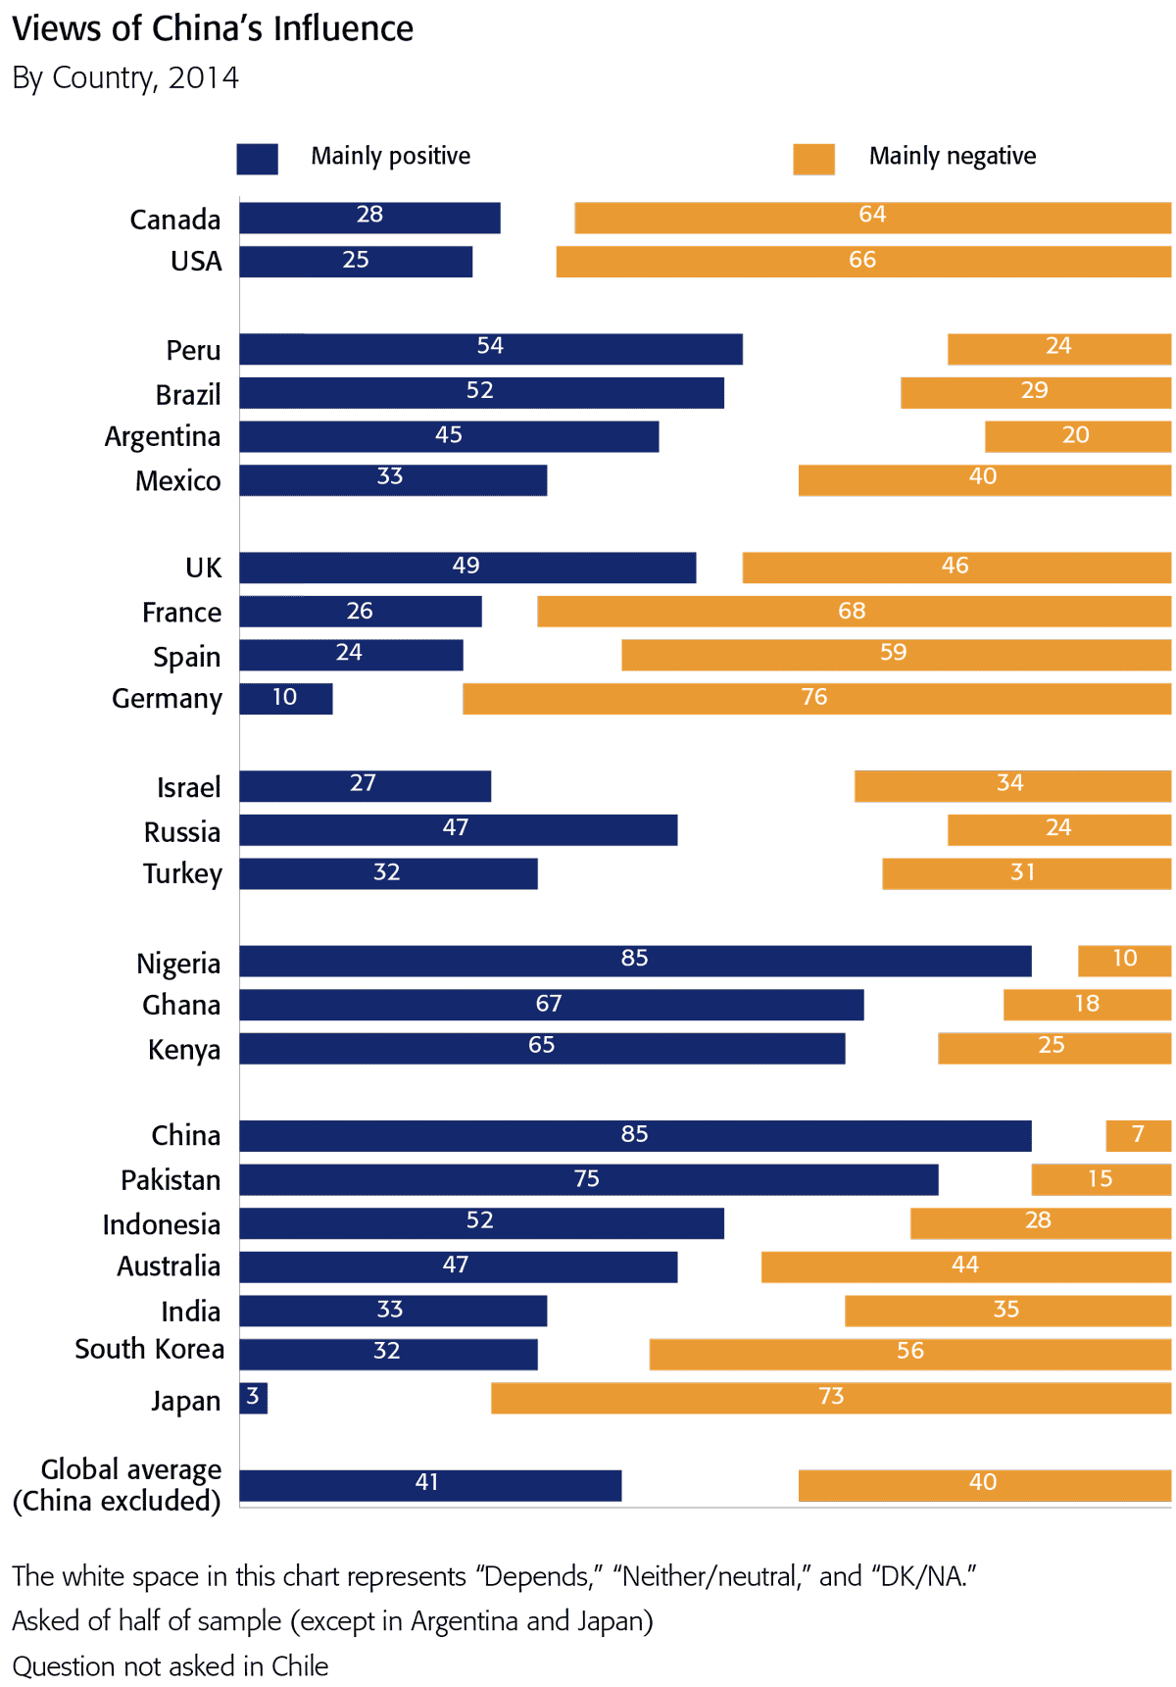
Stance Detection in Practice
[1] https://www.dw.com/en/turkey-softens-stance-towards-bashar-al-assad-in-syria-settlement/a-37211975
[2] https://www.colorado.edu/odece/2020/06/05/campus-solidarity
[3] Ruder, et al., 2018, 360 stance detection. NAACL: System Demonstrations (pp. 31-35).
[4] http://www.dailymail.co.uk/news/article-4237460/Trump-slams-press-Twitter.html
Notes:
Sentiment
Sarcasm
Irony

Slide 36
(MoLE) Mixture of Experts with Label Embeddings
Key characteristics:
Mixture of Experts (MoE) w/ Label Embeddings Layer (LEL)
Domain-Adversarial Neural Net (DANN)
Joint Label Space Voting
Parameter-Efficient Model
Shared
Notes:
Stable input representations (MoE + DANN)
Stable output representations (LEL)
Parameter-efficiency (Joint model)

Slide 37
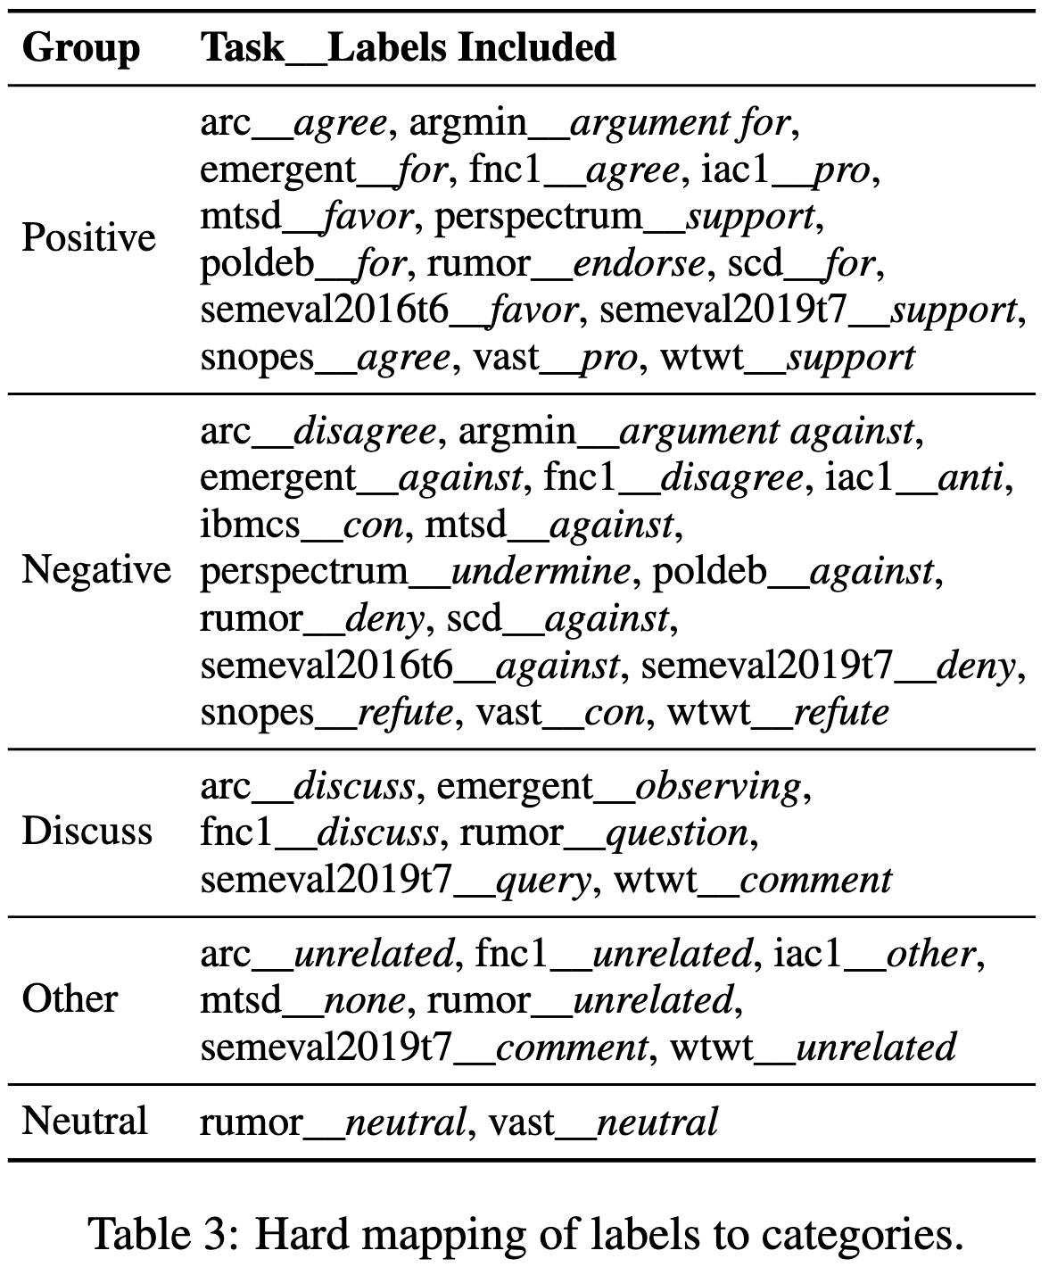
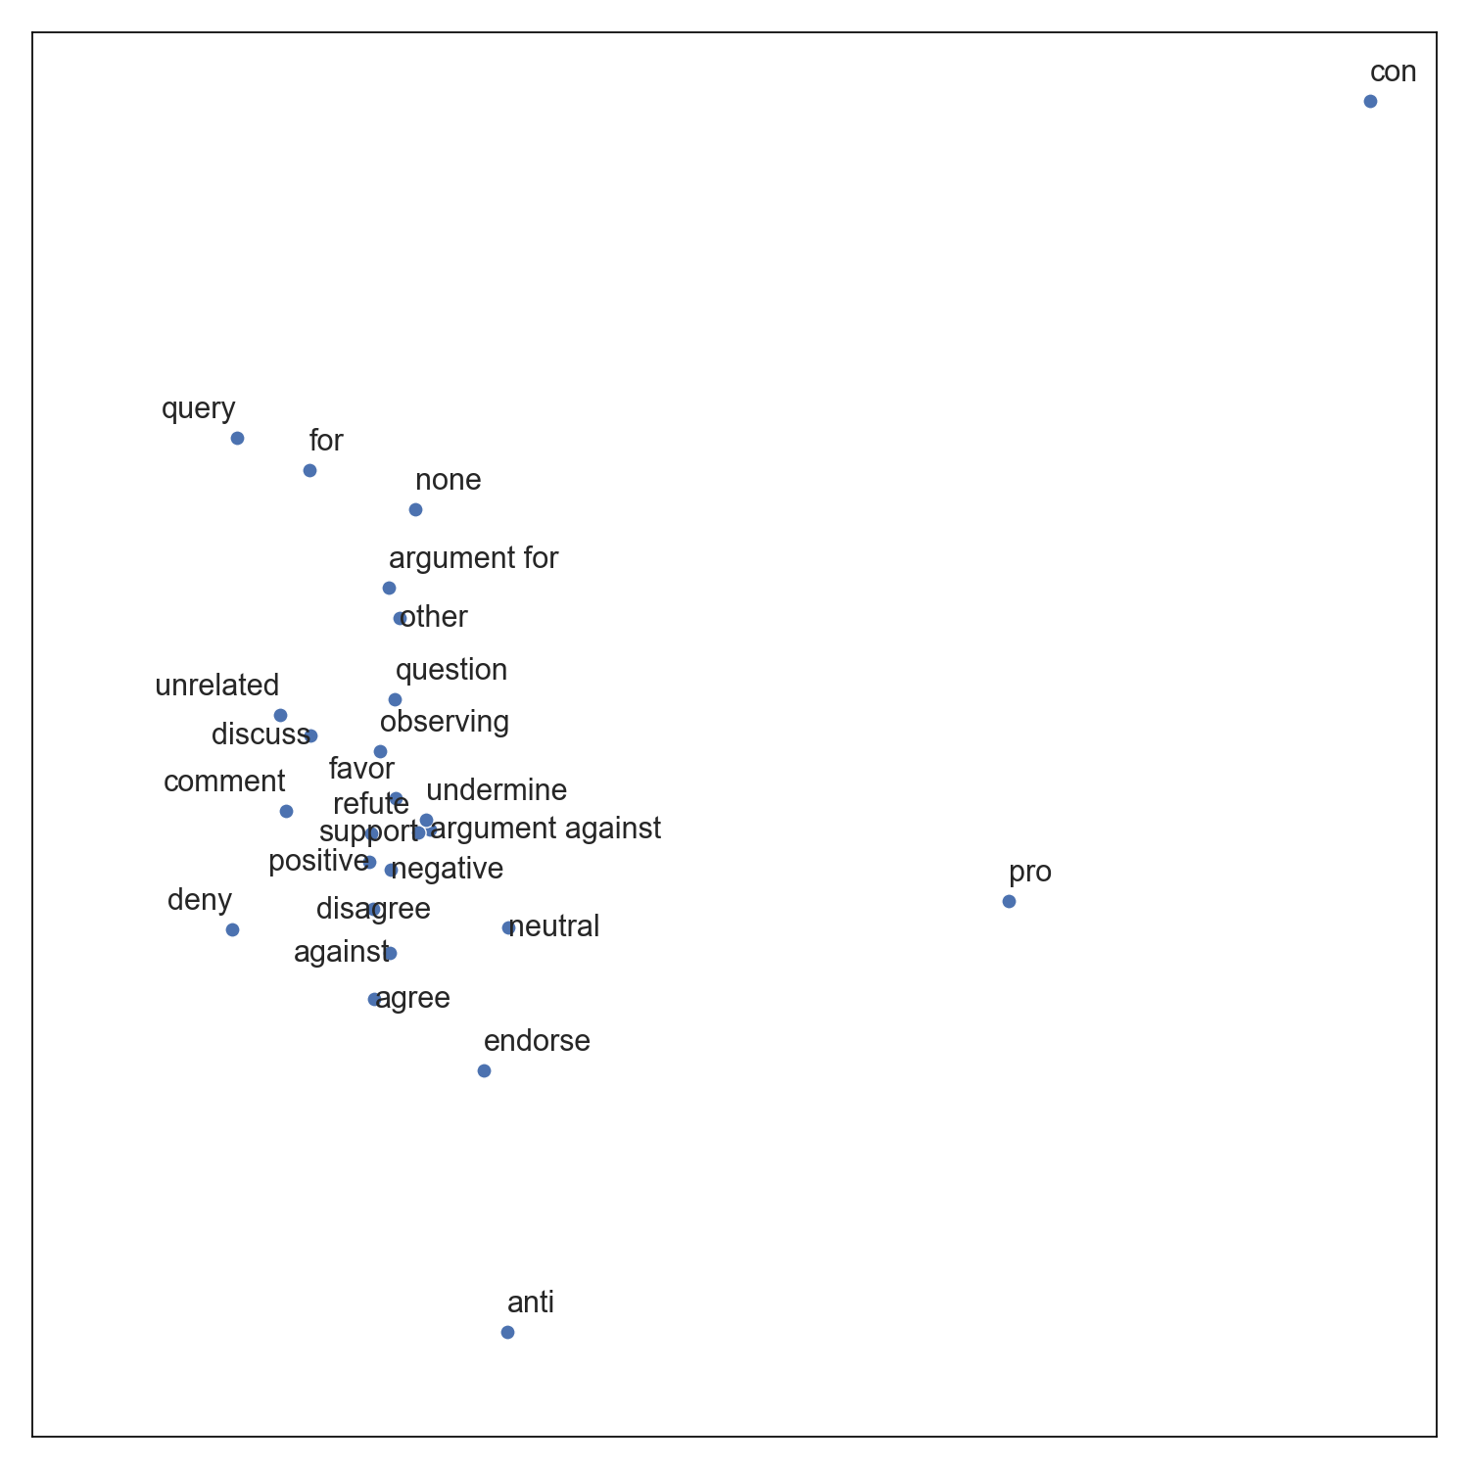
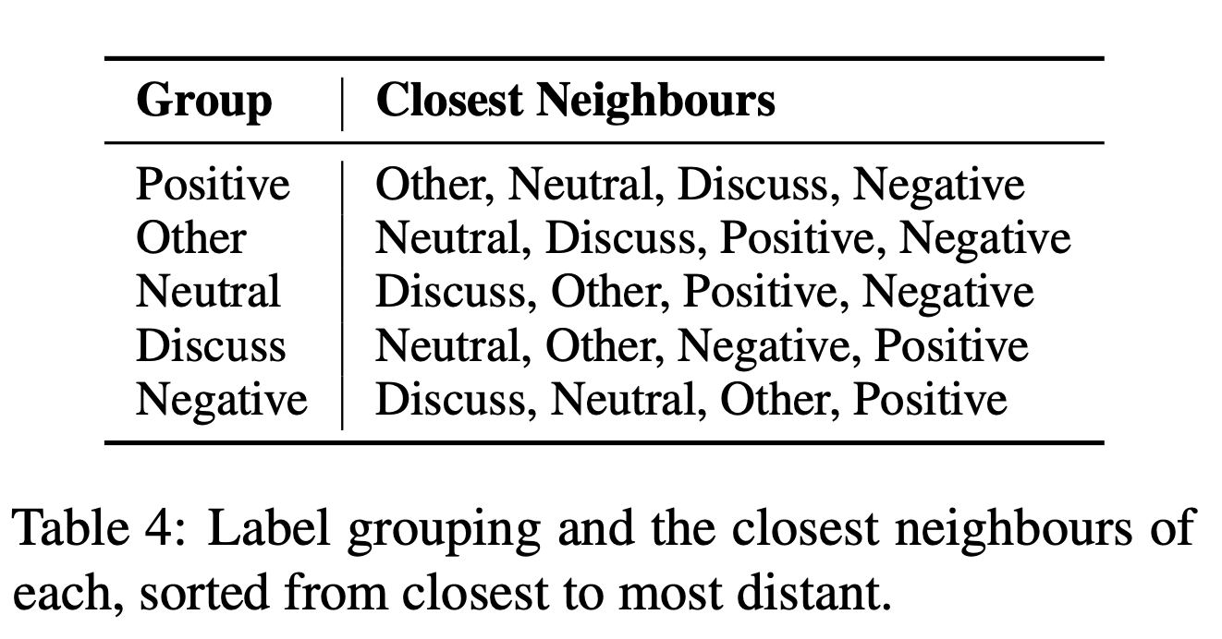
Predicting Unseen Labels
Types of Mappings
Hard Mappings
Weak Mappings
Soft Mappings

Slide 38
Overcoming the Limitations

Slide 39
Stance Detection: Definitions
(Stance Detection) For an input in the form of a piece of text and a target pair, stance detection is a classification problem where the stance of the author of the text is sought in the form of a category label from this set: {Favor,Against,Neither}... ^{[1]}
(Stance Detection Sociolinguistics) Stance detection aims to infer the embedded viewpoint from the writer’s text by linking the stance to three factors, namely, linguistic acts, social interactions, and individual identity.^{[2]}
(Stance Detection Social Media) Stance Detection is concerned with individuals’ views toward objects of evaluation through various aspects related to the users’ post and personality traits.^{[2]} The category label is chosen from the set: {Support, Deny, Query, Comment}...^{[3]}
[1] Dilek Küçük and Fazli Can. 2020. Stance Detection: A Survey. ACM Comput. Surv. 53, 1, 12
[2] AlDayel, Abeer, and Walid Magdy. "Stance detection on social media: State of the art and trends." Information Processing & Management 58.4 (2021): 102597.
[3] Mohammad, Saif, et al. "Semeval-2016 task 6: Detecting stance in tweets." Proceedings of the 10th international workshop on semantic evaluation (SemEval-2016). 2016.

Slide 40
Results: Out-of-Domain
Takeaways
Hard mappings are worse than random (Worst F1)
Weak mappings need hand-crafted embeddings for each label (Best F1)
Soft mappings are not always well aligned (but entirely unsupervised)
*Baselines: Random (35.2), Majority class (27.6)
Notes:
RoBERTa outperforms BERT

Slide 41
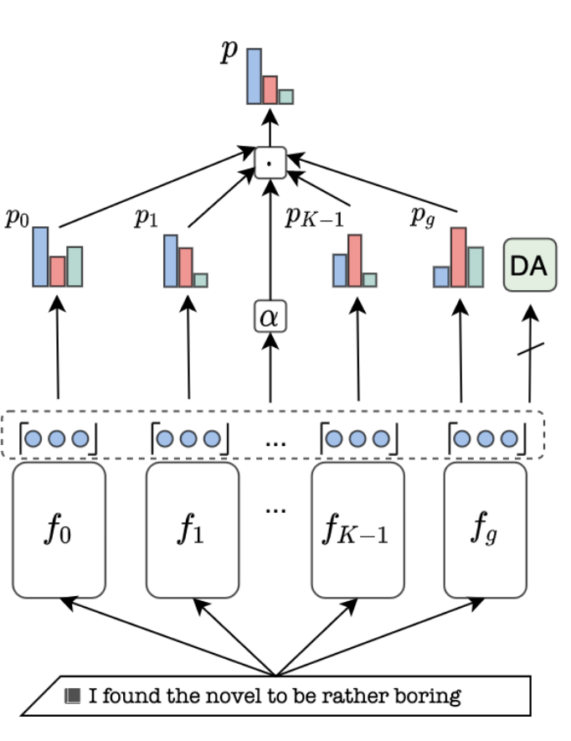
Existing Approaches and Their Limitations
Requires Shared Label Inventory Parameter- Inefficient
Disjoint Label Spaces No Domain Information
No Source Domain Information
(c) Mixture-of-Experts
[a,b] Augenstein, I., Ruder, S. and Søgaard, A., 2018, January. Multi-Task Learning of Pairwise Sequence Classification Tasks over Disparate Label Spaces. In NAACL-HLT. [c] Wright, D. and Augenstein, I., 2020, November. Transformer Based Multi-Source Domain Adaptation. In Proceedings of the 2020 Conference on Empirical Methods in Natural Language Processing (EMNLP) (pp. 7963-7974).
Notes:
MTL does not learn how the tasks interact (except through the shared encoder, if any)
LEL depends on the label embeddings space, but does not have any guidance from the domains
MoE needs the same label inventory for all tasks, that’s why it does not work with many

